Slide 1
The American Dream: An Introduction
By Dr. Chowdhury
May 8

Slide 2
U.S. Declaration of Independence (1776) by Thomas Jefferson, Benjamin Franklin, John Adams, and Colleagues
“. . . that all Men are created equal, that they are endowed by their Creator with certain unalienable Rights, that among these are Life, Liberty, and the Pursuit of Happiness.”

Slide 3
Inherent Contradiction
Promise of Inclusion vs. Hidden exclusion

Slide 4
Promise of Inclusion
Have talent, work hard & abide by law
Basic good living, security, justice, dignity
Even great wealth, success, & fame

Slide 5
Hidden Exclusion
“all Men are created equal”
property-owning educated, white, Anglo-Saxon , Protestant, males
Considered to be rational beings
“natural-born” leaders
Others better off being governed by white, Anglo-Saxon , Protestant, “gentlemen” like the Founding Fathers of America
White women of all classes
Poor white men
Enslaved black men & women
Few free black men & women
Non-Anglo Saxon white peoples: Irish, Eastern Europeans, etc.
Religious minorities: Catholics, Jews, Muslims
People of color: Hispanics/Latinos, Asians, etc.
Native Americans

Slide 6
The Story of the American Dream Since 1776
A story of how different excluded groups worked to break down the walls of exclusion

Slide 7
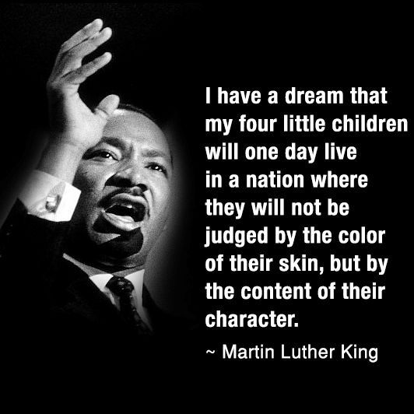
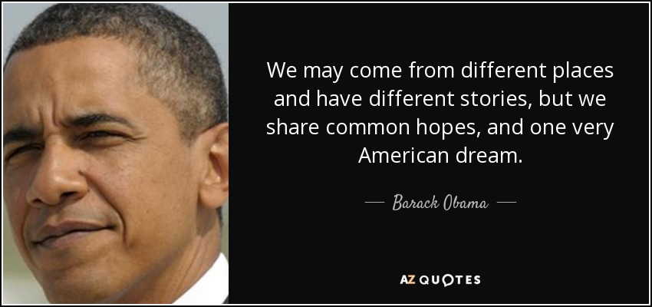
Two Great “Wall-Breakers”
Dr. Martin Luther King. Jr
President Barack Obama

Slide 8

The Great “Wall-Maker”

Slide 9
Discussion Topics Based on “Richard Cory” by Edwin Arlington Robinson & “The American Dream” by Ron Wallace (15 min)
Why does the narrator in “Richard Cory” envy Richard Cory?
What makes the poem’s ending so ironic?
How does the first stanza of “The American Dream” portray America as an inclusive country?
How does the second and last stanza show that the American Dream excludes others?

Slide 10
About “Richard Cory”
Cory—a self-made man, a success story
A man of the people—common man who has made it
A celebrity
A role model

Slide 11
More about Cory
Ultimately hollow
Isolated from original community
Unaccepted by upper-class
Probably lived beyond means on borrowed money/credit
A prototype for Jay Gatsby

Slide 12
About “The American Dream” by Wallace
“Even a puny mouse”=promise of inclusion for the underdog
Mickey Mouse cartoon stories=typical American Dream story line or plot
Talented hardworking ordinary man gets everything
A pretty wife
A nice house
Fame and admiration
security

Slide 13
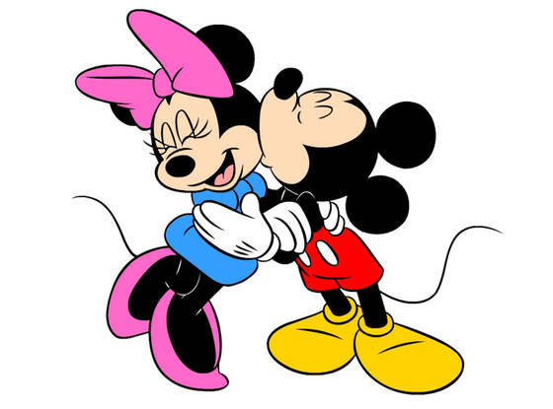
Mickey and Minnie Mouse

Slide 14
More about “The American Dream”
Is it really worth living this kind of American Dream life?:
a fake theme park existence
Entertaining others (like Gatsby)
For each success story there are many stories of failure: for each one included many excluded
Not everyone can be “Mickey Mouse”: the main character in an American Dream Story
Most are failures—frustrated and disappointed

Slide 15
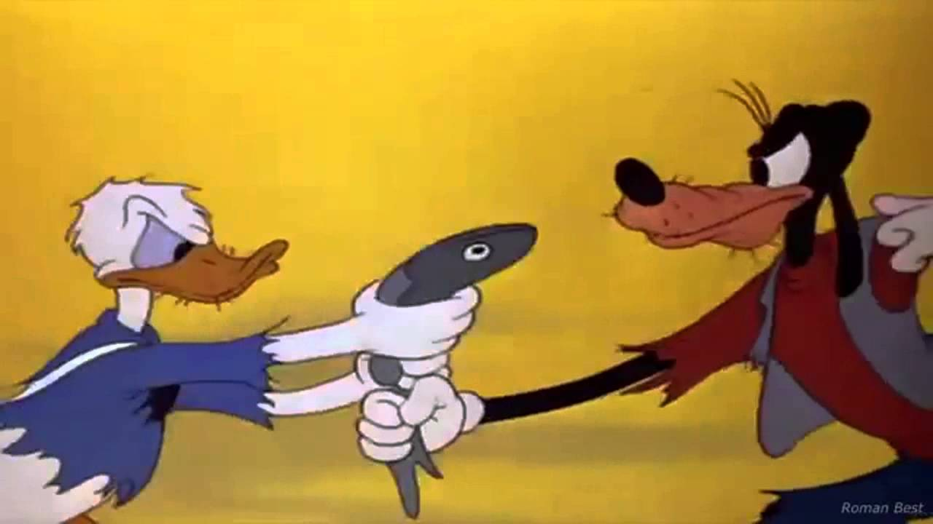
Donald Duck & Goofy

Slide 16
More Topics (20 min)
What “dreams” does the speaker say “America also dreams” (line 3) in “American Dreams” by Louis Simpson?
What effects do these “American dreams” have on the speaker in this poem? Why?
What does the narrator in “Volar” by Judith Ortiz Cofer dream of becoming? What is ironic about her dreams?
What could the narrator’s “superpowers” symbolize with relation to the American Dream?
What makes the parents in “Volar” the real superheroes instead of the superheroes in American comic books?

Slide 17
About “American Dreams”
Contrast between immigrant/speaker’s dream and the “dreams” dreamt by America as a nation
He dreams of “life” and “loves that were slender as gazelles” (lines 1-2)
America dreams of conquering and dominating

Slide 18
About “Volar”
Immigrant girl struggling with self-image & fitting in
Supergirl: attractive, female white American
Narrator: thin, dark, unattractive Latina girl

Slide 19
More about “Volar”
Super-powers symbolic:
Flying= attain higher social class through hard work
Seeing through walls: overcoming exclusion
Super breath: fight against social injustice

Slide 20
More about “Volar”
The parents
First-generation immigrants
Excluded and isolated
Speaks Spanish
Father talks only about barrio
Mother dreams of flying home
Clock symbol
The narrow, dirty alley as symbol
Too narrow for parents
Just enough space for “skinny child”

Slide 21
Last bit about “Volar”
Parents real superheroes
Endures exile from own land and culture
Endures isolation and discrimination in new country
negative stereotypes about Puerto Ricans
Gives daughter the best
Protects her from physical and psychological harm
Gentle, kind, and patient

Slide 22
Homework #1 Due May 10
Answer the following question (250-300 words, typed & double spaced):
What does the noun “requiem” mean? What are some important reasons and examples given by Noam Chomsky to justify calling his film A Requiem for the American Dream?

